Slide 1
Game Sales Analysis
By Luther Dai, Freya Dave, Clark Gaston

Slide 2

TABLE OF CONTENTS
Objectives
01
Exploratory Analysis
02
Our Model
03
Conclusion
04
Predicting future sales in different markets
Initial Findings
Intro & Performance
Business advice for the client

Slide 3


Objective
Our client wants to get into the video games business. We are trying to predict future sales in different markets based on past sales.

Slide 4

Exploratory Analysis
Our Data
Data records game sales from 1980 to 2015.
Data includes name of the game, release year, genre, publisher, platform, and sales.

Slide 5
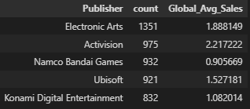
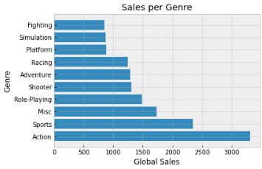
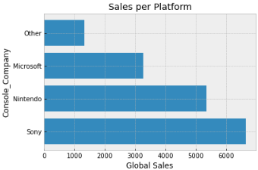
EDA Findings
Top Selling Publishers
EA
Activison
Namco Bandai
Top Game Genres
Action
Sports
RPG
Best selling Platforms
Sony
Nintendo
Microsoft

Slide 6
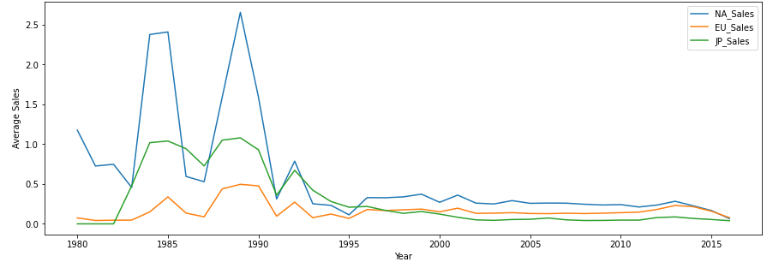
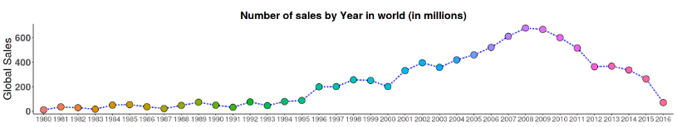
EDA Findings cont.
Average sales by year
Break down by major markets
Global sales by year

Slide 7

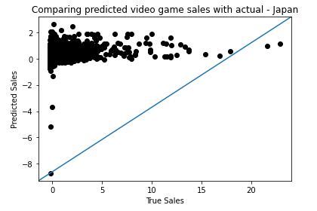


Linear Model Overview
Intro
Performance
We attempted to build a model to predict video game sales using a linear model with PCA and other feature engineering.
Model was not able to predict video game sales at all (R-sq < 0.01) in the test set for global sales, North American sales and EU sales
R-sq of .1335 for Japanese sales suggests mild predictive power for the independent variables in this application
Our hypothesis was that given game genre, year, publisher, and console we would be able to predict how well a game would sell in a certain region. Features like Console company and platform type were imputed from the data for this model.

Slide 8
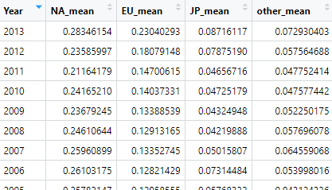
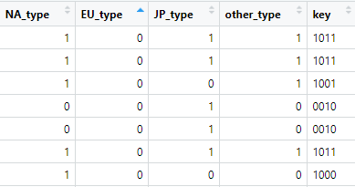
Random Forest: Feature Engineering
Original Dataset
Feature Engineering and Variable Selection
Average sales by year for a region
Type
Sales > Mean = 1
Sales <= Mean = 0

Slide 9
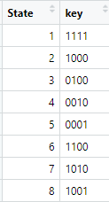
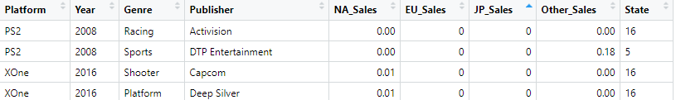
Random Forest: Feature Engineering
16 Buckets
Variables used in the Model
Model
rf = randomForest(State~., data)

Slide 10
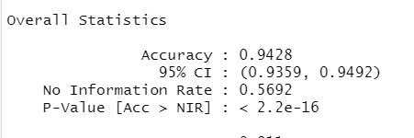
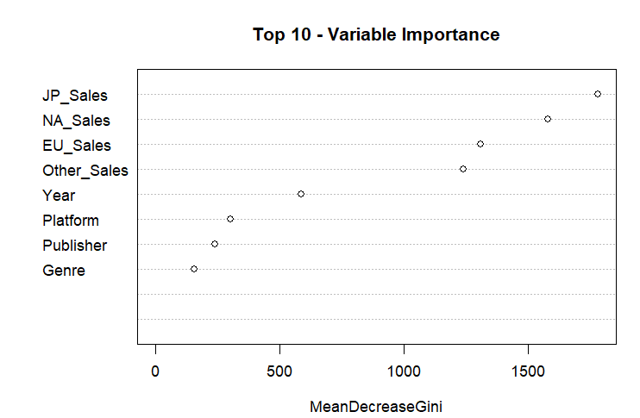
Random Forest: Output
Gini Coefficient shows the importance of each variable in the random forest classifier

Slide 11

Conclusion
Conclusion 1
Conclusion 2
Linear model cannot accurately predict future sales with the data we have.
We are able to classify, with 94% accuracy, whether a video game will outperform average sales in a certain region, by year, based on the independent variables included in this dataset.

Slide 12
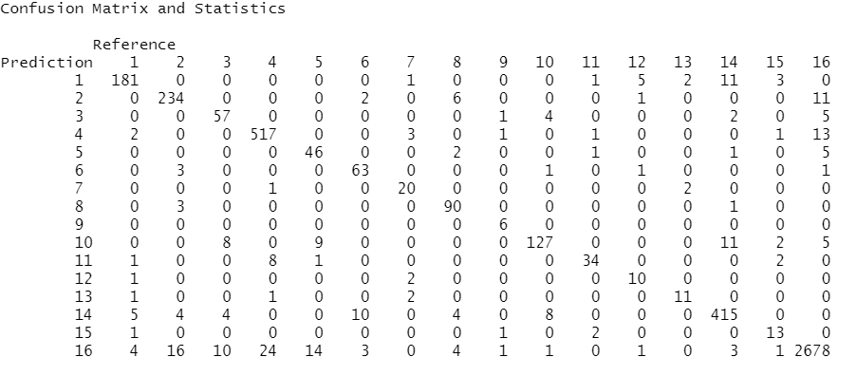
Appendix
Random forest test data confusion matrix

